Slide 1
JQuery
Dr. Swarna Priya RM SITE

Slide 2
Introduction
jQuery is a JavaScript Library.
jQuery greatly simplifies JavaScript programming.
jQuery is a lightweight, "write less, do more“
simplifies a lot of the complicated things from JavaScript, like AJAX calls and DOM manipulation.

Slide 3
Features
HTML/DOM manipulation
CSS manipulation
HTML event methods
Effects and animations
AJAX
Utilities

Slide 4
Usage
Production version
Development version
Both versions can be downloaded from jQuery.com.
<head>
<script src="jquery-3.6.0.js"></script>
</head>

Slide 5
Syntax
$(selector).action()
$(this).hide()
$("p").hide()
$(".test").hide()
$("#test").hide()
hides the current element.
hides all <p> elements.
hides all elements with class="test".
hides the element with id="test".

Slide 6
Enclosure
$(document).ready(function(){
// jQuery methods go here...
});

Slide 7
JQuery Selectors
start with the dollar sign and parentheses: $()
$("p") - Element Selector
$(document).ready(function(){
$("button").click(function(){
$("p").hide();
});
});

Slide 8
ID Selector
$(document).ready(function(){
$("button").click(function(){
$("#test").hide();
});
});

Slide 9
Class Selector
$(document).ready(function(){
$("button").click(function(){
$(".test").hide();
});
});

Slide 10
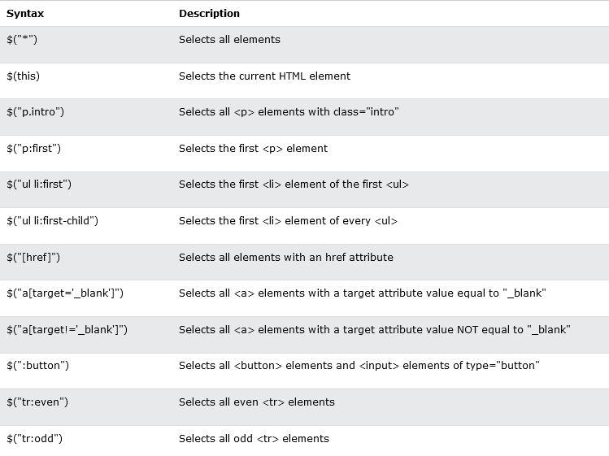

Slide 11
Events
$("p").click(function(){
$(this).hide();
});
$("p").dblclick(function(){
$(this).hide();
});

Slide 12
Events
$("#p1").mouseenter(function(){ alert("You entered p1!");
});
$("#p1").mouseleave(function(){ alert("Bye! You now leave p1!");
});

Slide 13
$("#p1").mousedown(function(){ alert("Mouse down over p1!");
});
$("#p1").mouseup(function(){ alert("Mouse up over p1!");
});

Slide 14
hover()
$("#p1").hover(function(){ alert("You entered p1!");
},
function(){
alert("Bye! You now leave p1!");
});

Slide 15
focus & blur
$("input").focus(function(){
$(this).css("background-color", "#cccccc");
});
$("input").blur(function(){
$(this).css("background-color", "#ffffff");
});

Slide 16
On event
$("p").on({
mouseenter: function(){
$(this).css("background-color", "lightgray");
},
mouseleave: function(){
$(this).css("background-color", "lightblue");
},
click: function(){
$(this).css("background-color", "yellow");
}
});

Slide 17
Effects
hide()
show()
toggle()
$("button").click(function(){
$("p").hide(1000);
});
$("button").click(function(){
$("p").toggle();
});

